Slide 1
Assessing Emoji Use in Modern Text Processing Tools
Group-18
Members
AMINUL ISLAM ANIK- 22366038
AMIT DUTTA- 21166028
ADNAN KARIM - 18101592

Slide 2
Introduction
Need for systems to operate on text containing emojis.
Finding the ability of prominent NLP and test processing through experimentation.
Standard tasks like tokenization, parts-of-speech, dependency and sentiment analysis.
Special considerations like skin tone modifiers and composite emoji incorporating multiple basic emojis.
Notable deficiency in the current tools in coping with modern emoji usage.
Many systems still have shortcomings on working with emojis.

Slide 3
Related Work
Popular since incorporation into Unicode 6.0
Affected both semantic and pragmatic aspects.
Pros and cons of toolkits such as Stanza, NLTK.
Academic studies presenting newer models for particular NLP relating to emojis.

Slide 4
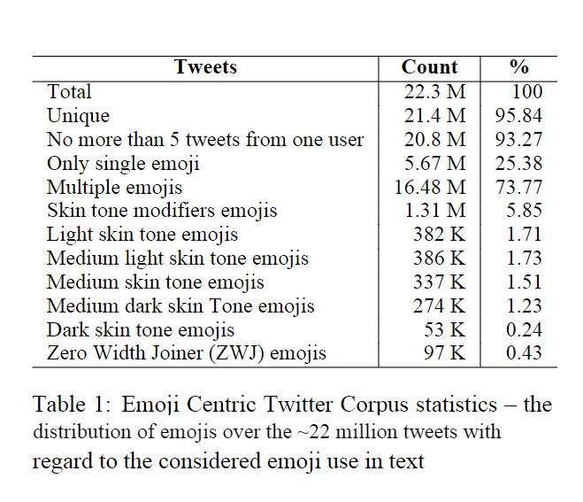
Experimental Data
Different aspects such as number, position, skin tone modifier etc.
Selected compilations of tweet from earlier 2019 based on a set of most frequently used emojis, “EmoTag”.
Representative samples.
Input texts are assessed through NLP tasks.

Slide 5
Tasks and Tools
Tasks
Tokenization
Part-of-speech Tagging
Dependency Tagging
Sentiment Analysis
8 NLP Libraries:
Gensim
NLTK
NLTK-TT
PyNLPl
SpaCyMoji
Stanza
TextBlob

Slide 6

Tokenization
Segment a text into tokens such as words, emojis, and other special characters.
A tokenizer should distinguish an emoji from a word even in the absence of a space delimiter.
if multiple emojis occur in a sequence, they are expected to be recognized as individual tokens.
An ideal tokenizer should not split skin tone emoji into two individual characters
an ideal tokenizer should not split up a Family Emoji as four individual emojis
Family emoji
Multiple emoji
Skin tone emoji

Slide 7
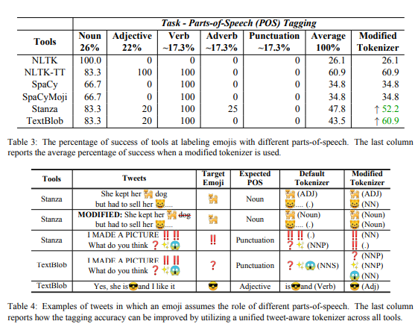
Part-of-Speech Tagging
This is the process of assigning each token a label that reflects its word class or parts of speech.

Slide 8
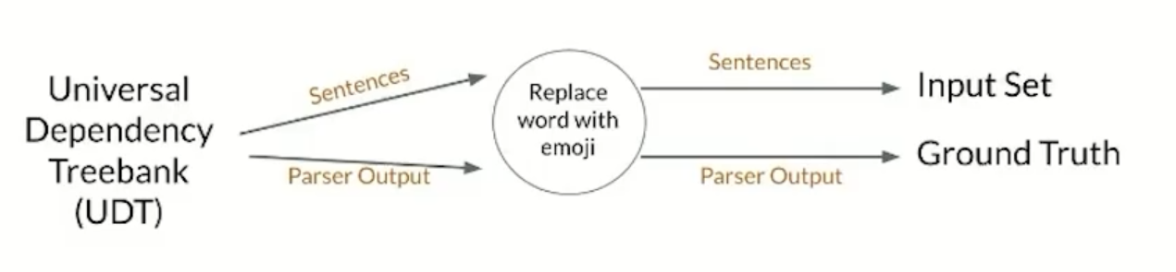
Dependency Parsing
English Web Treebank
EWT with single emoji
Single Emoji subtree
EWT with multi emoji
CoreNLP, SpaCy, and Stanza.

Slide 9
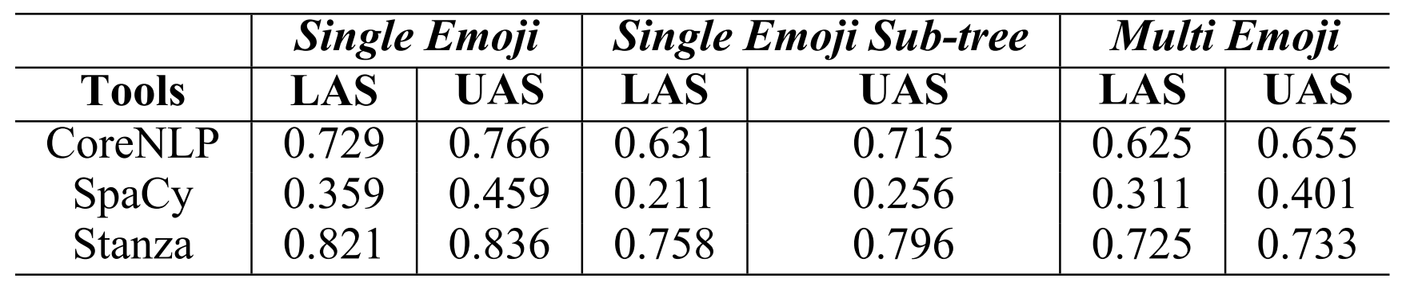
Dependency Parsing Results

Slide 10
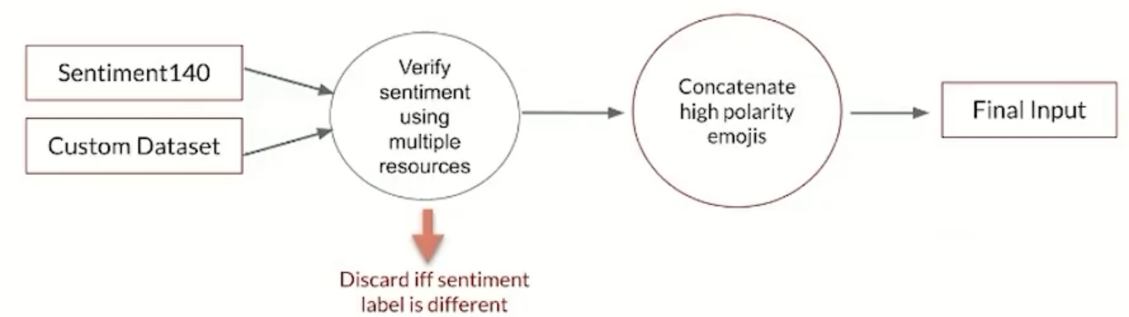
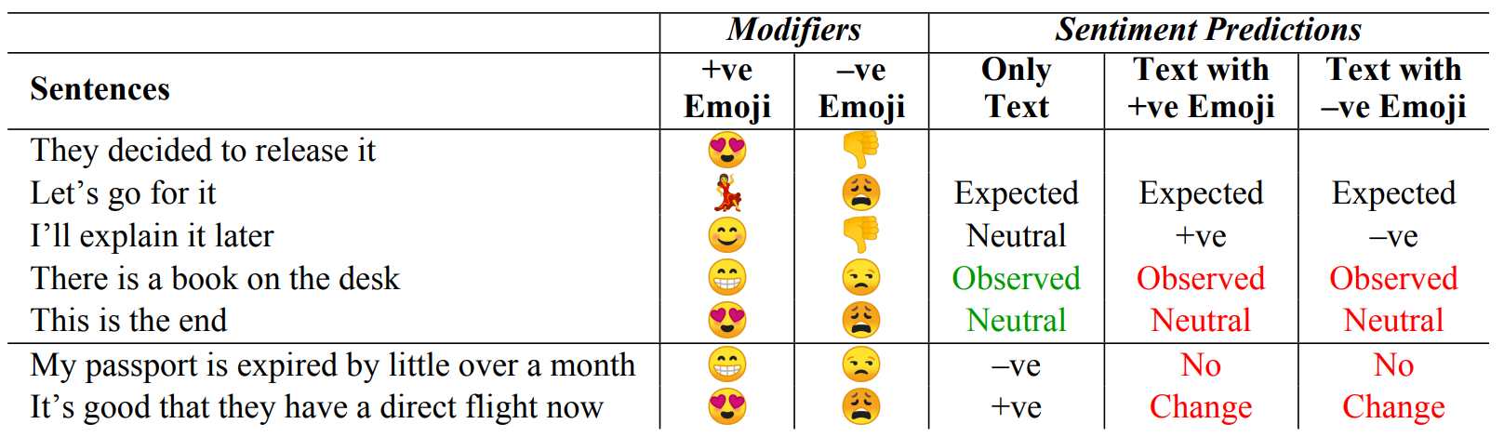
Sentiment Analysis

Slide 11
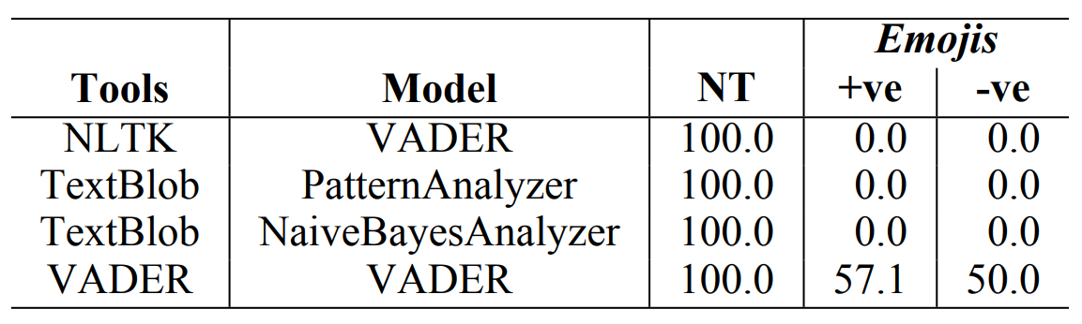
Sentiment Analysis Results

Slide 12
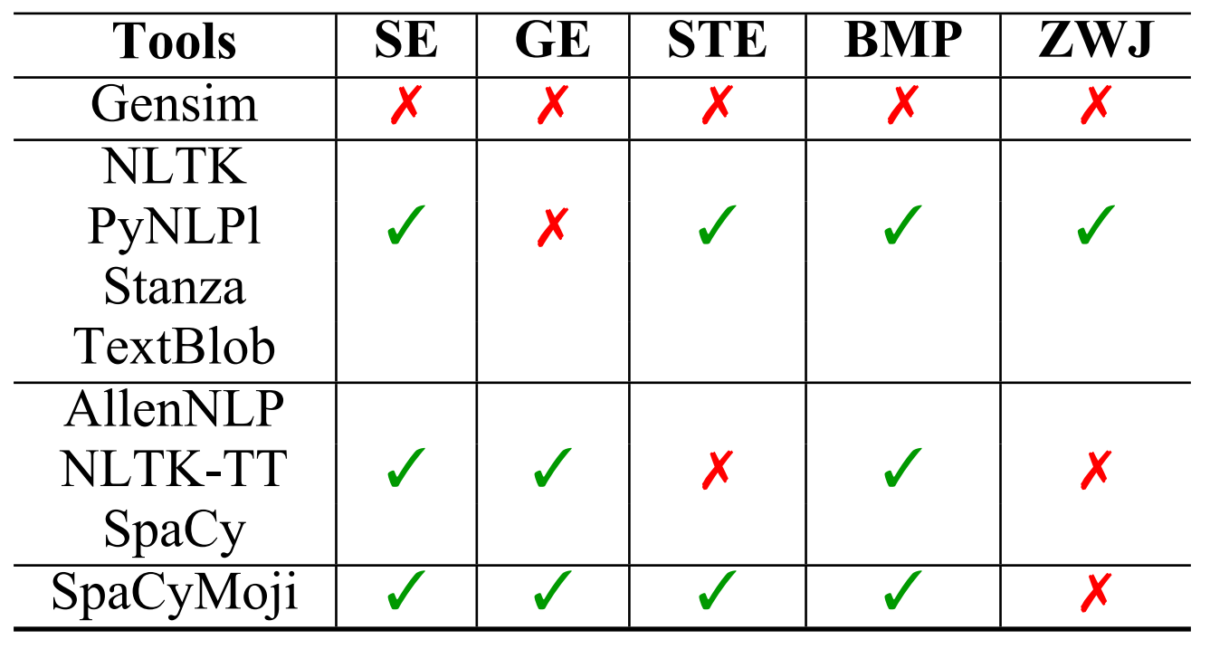
Conclusion
Need custom tool for every dataset

